Slide 1
Programming 1 - WEEK 5
Skills

Slide 2
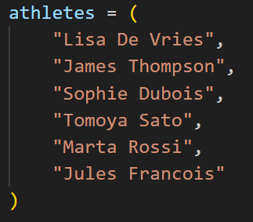
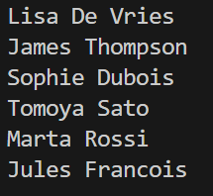
Athletes (1)
Imagine you’re developing a small application for a sports event. You are given a tuple with the names of all the athletes. Write a function to print out all the names.
Given: Result:

Slide 3
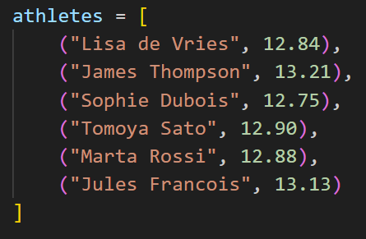
Athletes (2)
Imagine you’re developing a small application for a sports event. You are given a list of tuples with the names of all the athletes and their finish time in seconds. Write a function to print out all the names.
Given: Result:

Slide 4

Athletes (3)
Imagine you’re developing a small application for a sports event. You are given a list of tuples with the names of all the athletes and their finish time in seconds. Write a function that returns the athlete with the best (lowest) time.
Given: Result:

Slide 5
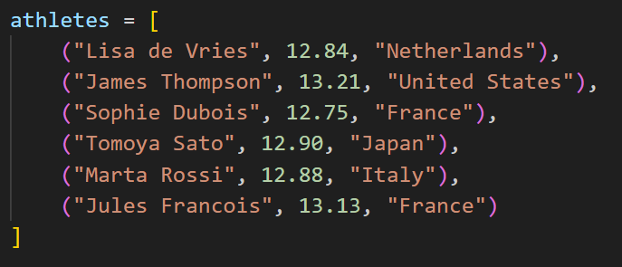

Athletes (4)
Imagine you’re developing a small application for a sports event. You are given a list of tuples with the names of all the athletes, their finish time in seconds and their country of origin. Write a function that returns the number of unique countries.
Given: Result:
Notes:
Nieuwe lijst maken, landen er aan toevoegen als ze nog niet in de lijst voorkwamen.

Slide 6
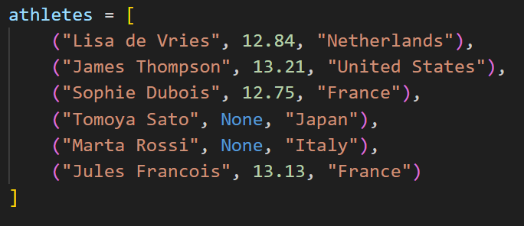
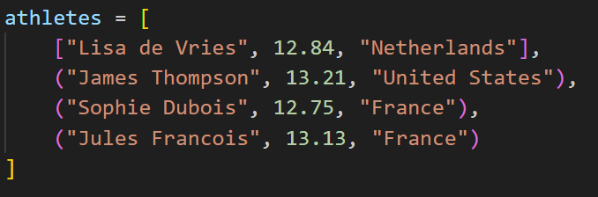
Athletes (5)
Imagine you’re developing a small application for a sports event. You are given a list of tuples with the names of all the athletes, their finish time in seconds and their country of origin. Write a function that removes the athletes that don’t have a finish time from the given list.
Given: Result:

Slide 7
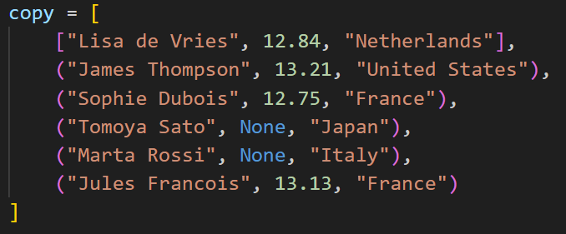
Athletes (6)
Imagine you’re developing a small application for a sports event. You are given a list of tuples with the names of all the athletes, their finish time in seconds and their country of origin. In order to protect your data, you should write a function that returns a copy of the given list.
Given: Result:

